Slide 1
Bank Network
218 Prerana Kolunkar
219 Aditya Gaikwad
222 Shantanu Jambhule
Guide: Mr. Sunilkumar Bhagat

Slide 2
Introduction
New Branch Implementation: A Bank is setting up a new 2-storey branch in Home city. The branch manager has approached your team to design and implement their organization network.

Slide 3
Problem Statement
Secure Network Implementation for Bank using ASA firewall in
CISCO-Packet-Tracer.

Slide 4
Objectives
To design and simulate a banking network system which is secure.
To simulate a banking network system that will easily manage any banking task.
To manage the banking network by a central system

Slide 5
Requirements
The bank consists of 3 locations in the city.
One for main office and two other branches.
All branches should communicate with each other.
All the branches should get their IP through DHCP.
Provide services like http, ftp, etc.
Install firewall for security.
Use routers/switches wherever required.

Slide 6
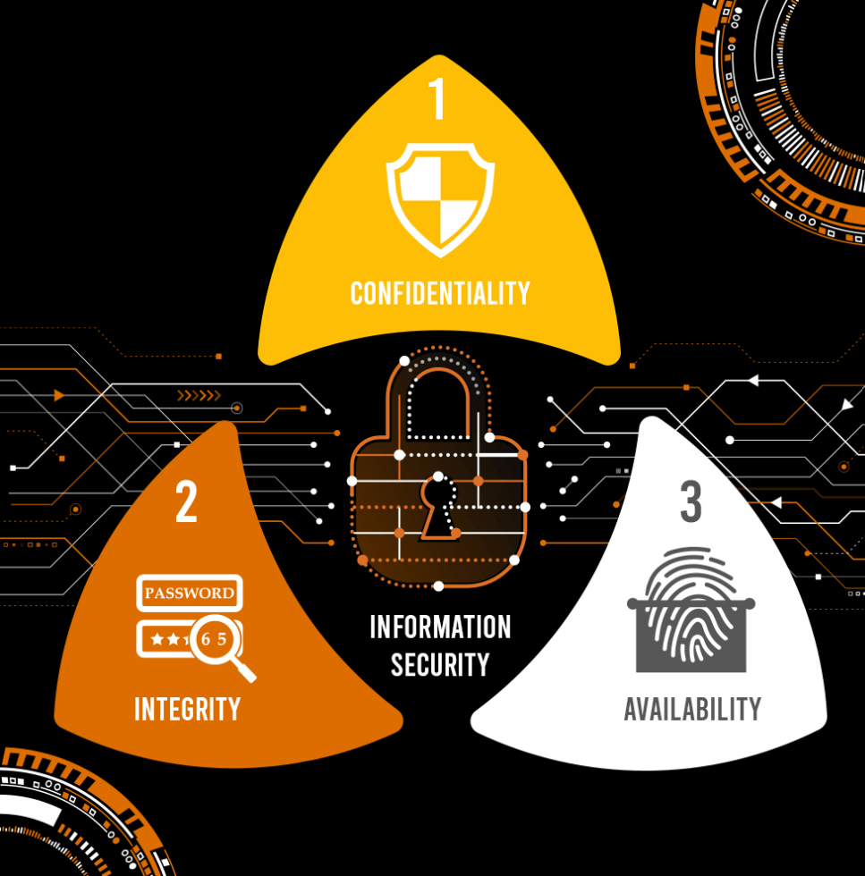
The CIA Triad
Confidentiality:
Only people in the bank network itself have access to the information.
Integrity:
Information can be modified after confirmation.
Availability:
Information available whenever needed.

Slide 7
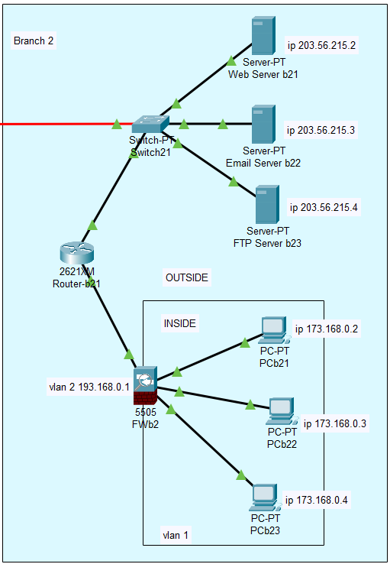
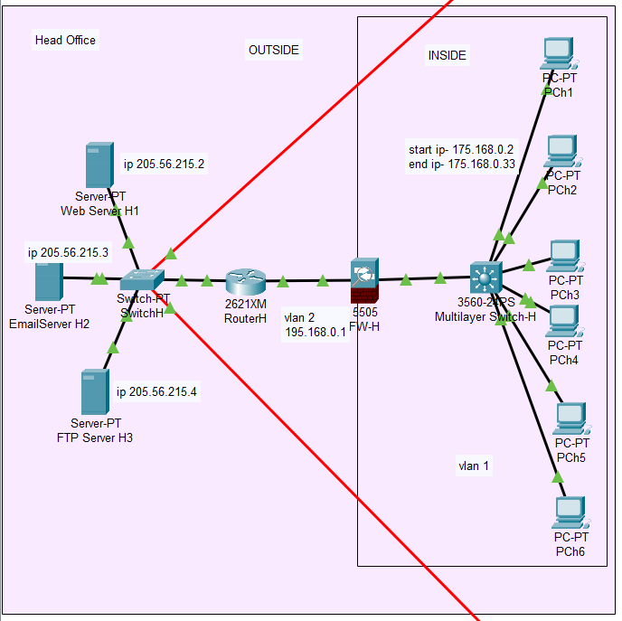
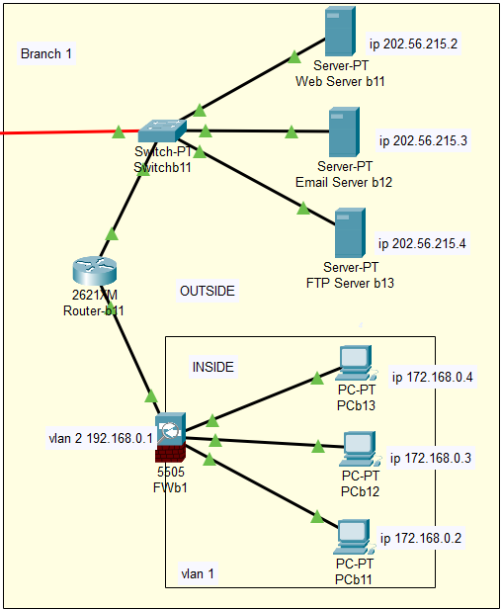
Implementation

Slide 8
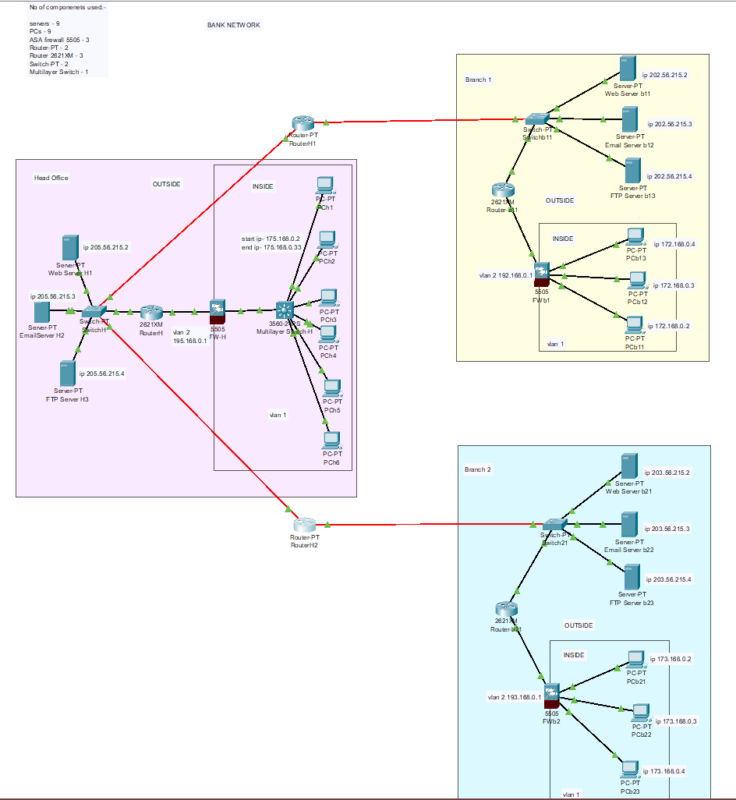
Implementation

Slide 9
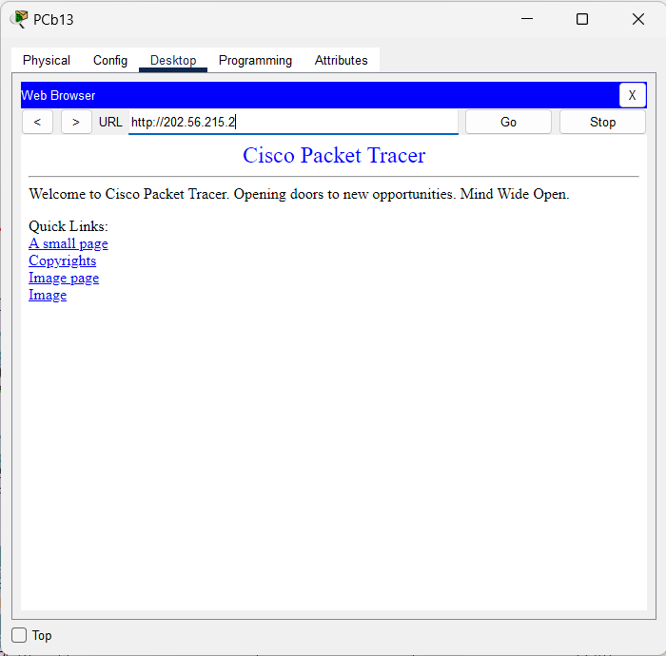
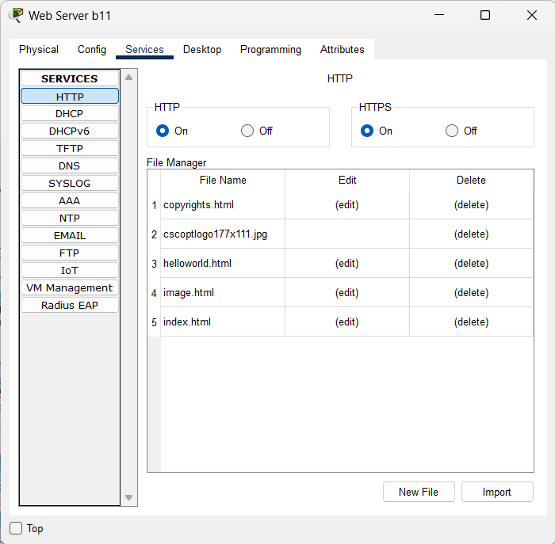
Services Provided
HTTP Service at each network

Slide 10
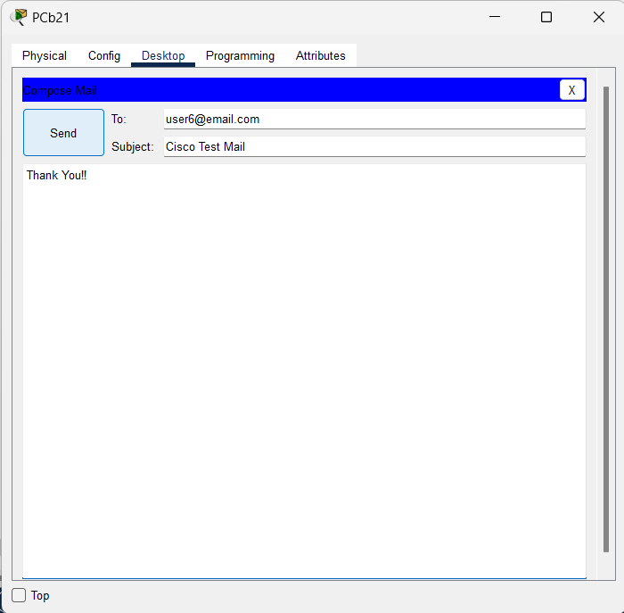
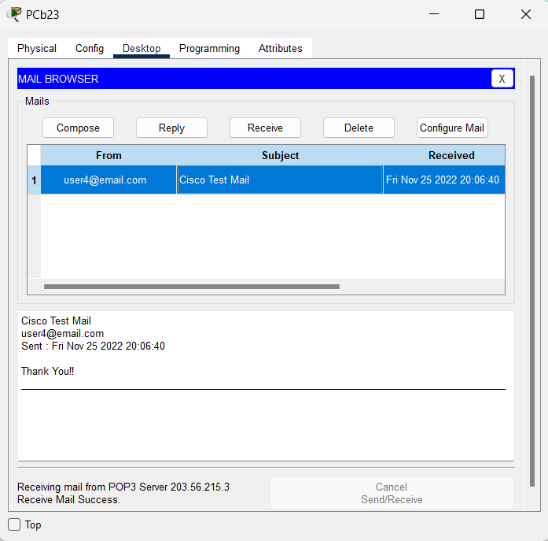
Services Provided
Email Service at each network

Slide 11
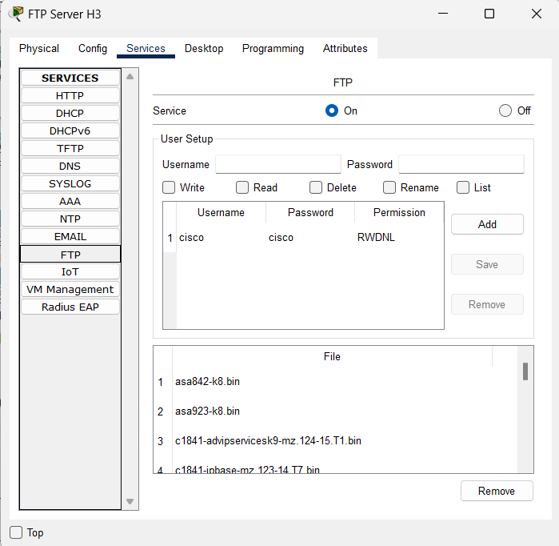
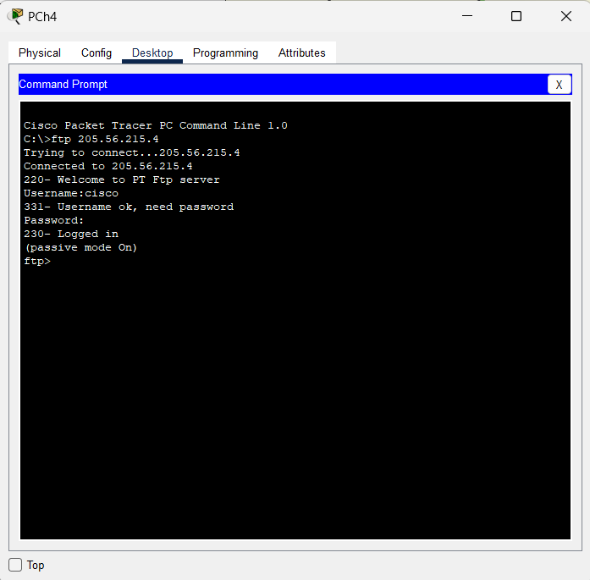
Services Provided
FTP Service at each network

Slide 12
Reference
https://www.cisco.com/
https://www.packettracernetwork.com/
https://www.academia.edu/
www.networkessential.com
Data Communications and Networking By Behrouz A. Forouzan
Computer Networks From Scratch

Slide 13
Thank You!

